Slide 1
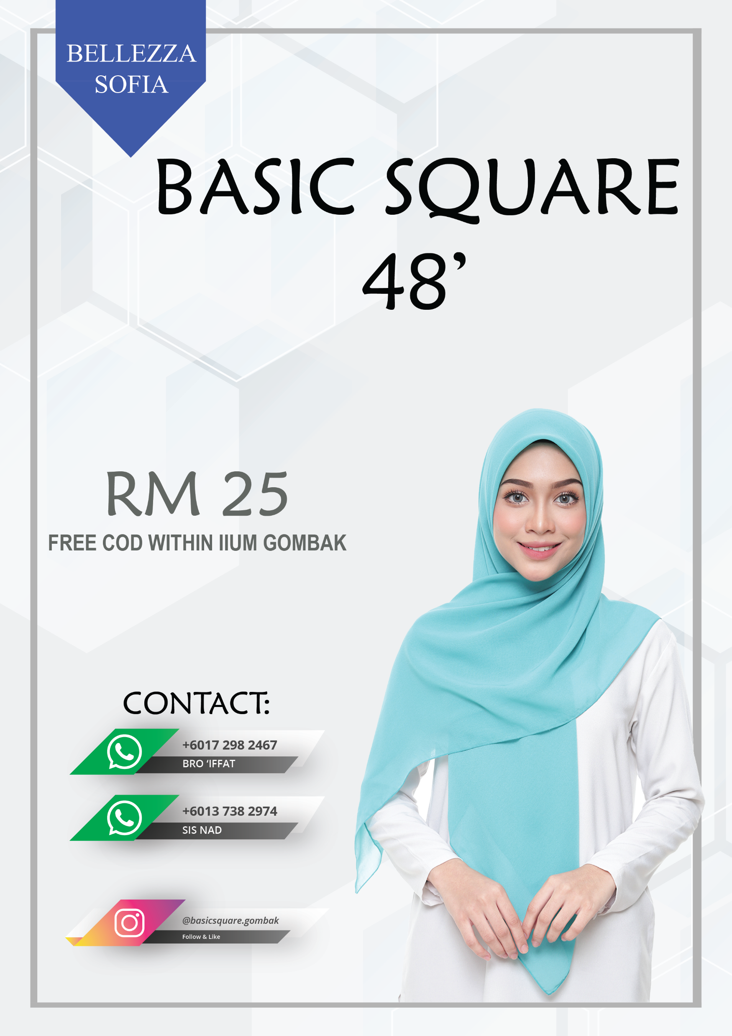
BASIC SQUARE 48’
WEAR WITH CONFIDENT

Slide 2
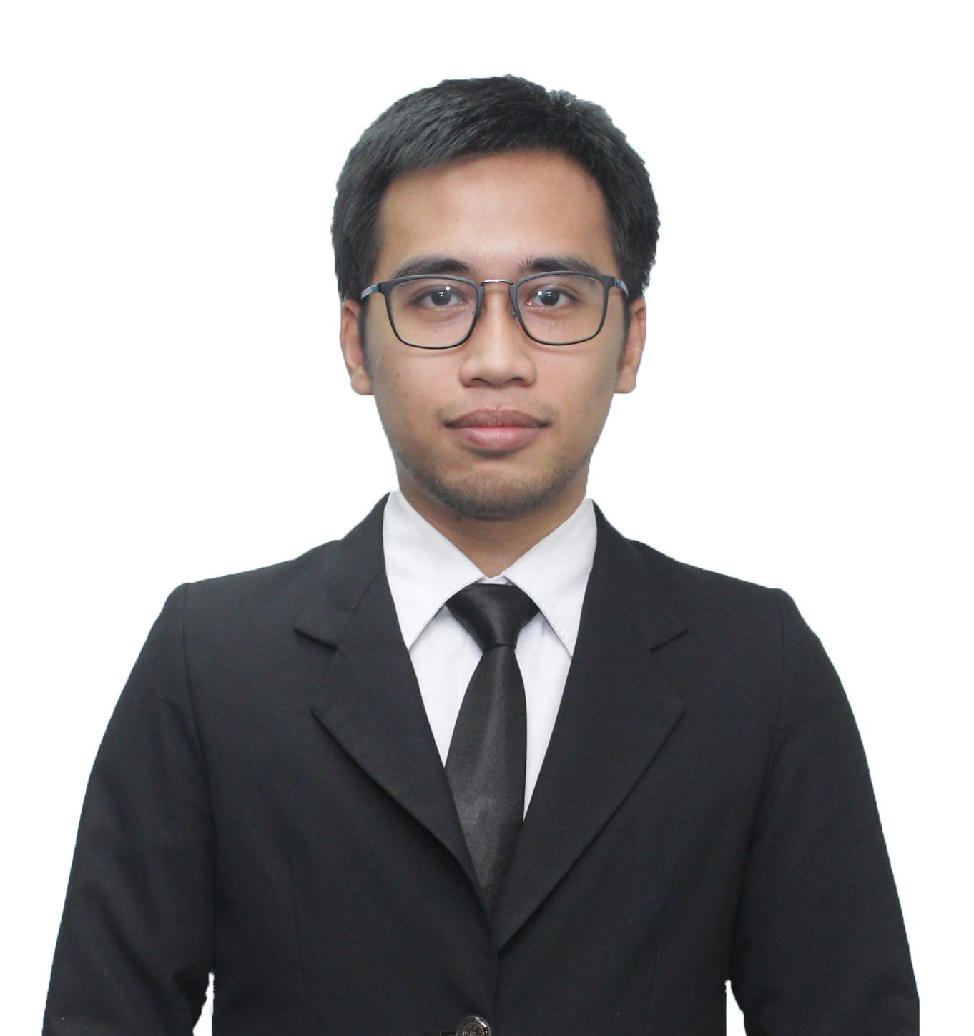
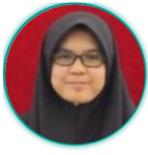
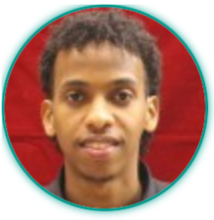
CHART OF ORGANIZATION
CEO
Muhammad 'Iffat bin Mohamed 'Ashri
CFO
Nur Nadhirah bt Shamsul Nizam
CTO
Abdirahman Abdullahi Mohamed Mursal

Slide 3
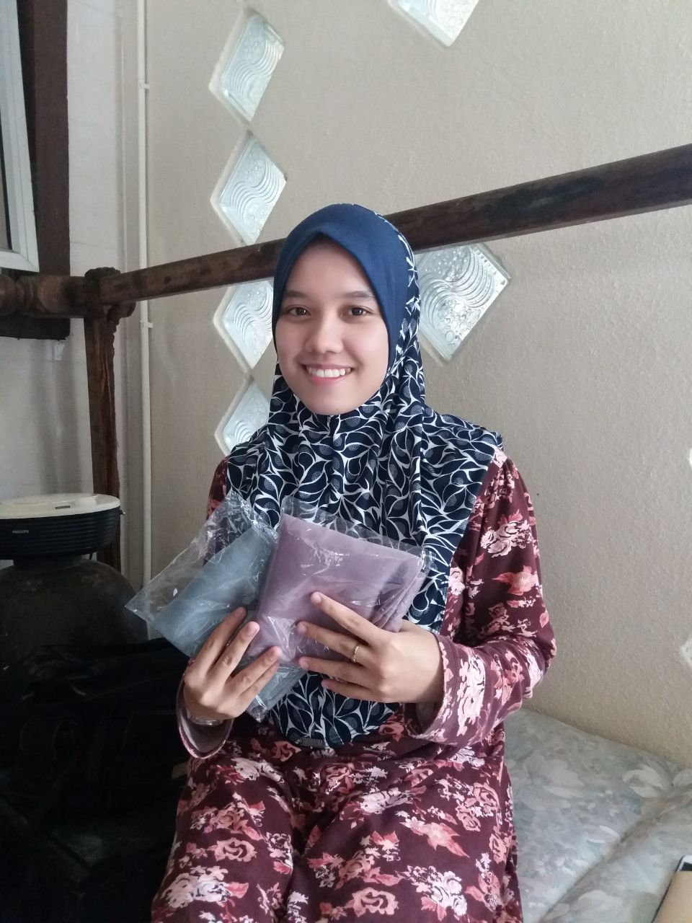
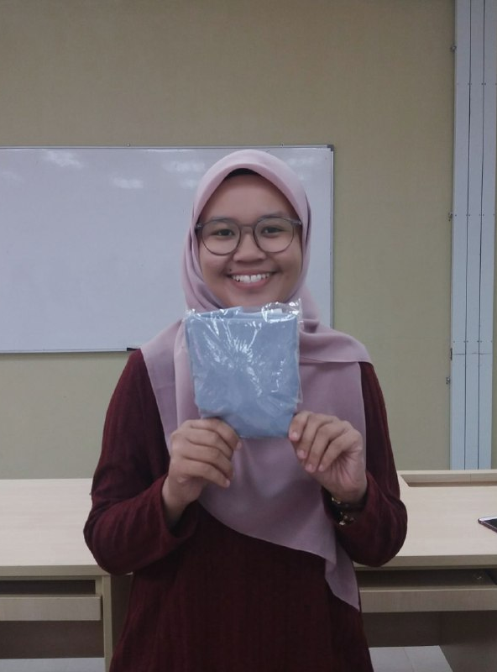
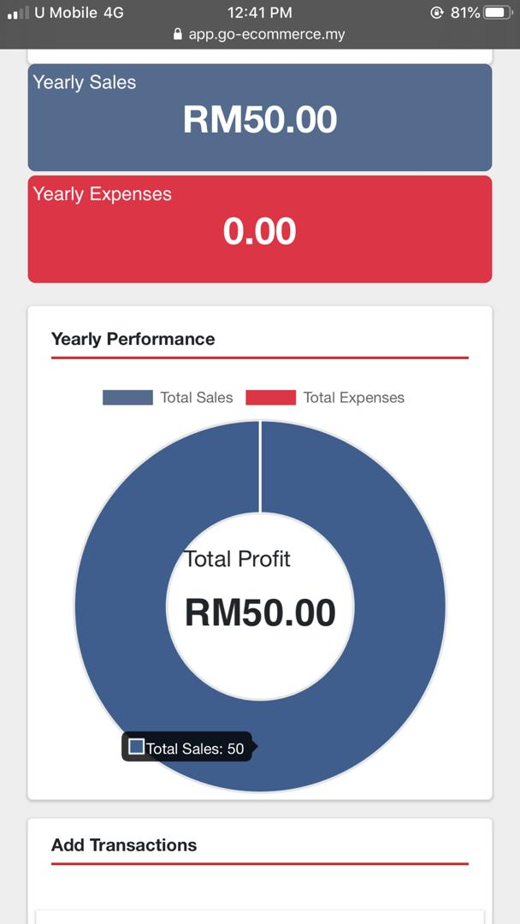
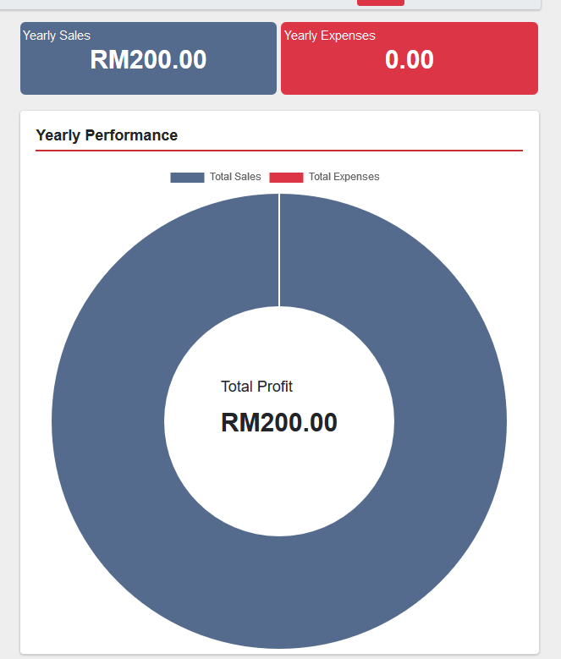
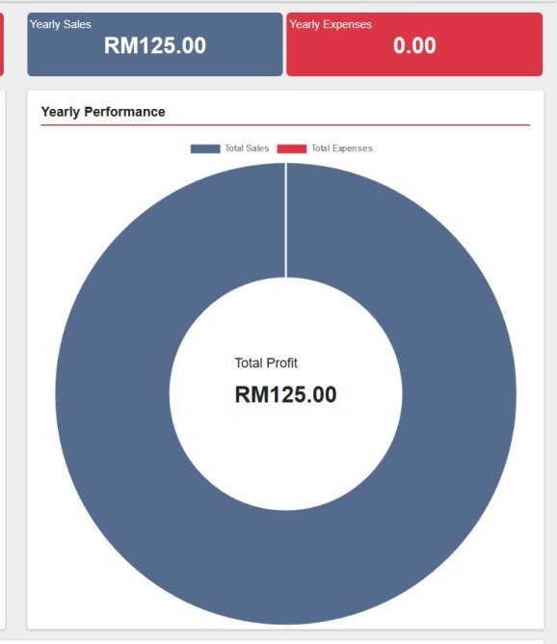
Achievement
SALES
TOTAL SALES: RM375

Slide 4
CHALLENGES & HOW TO SOLVE
Challenges | Resolve
Not enough capital to be the official agent of that particular brand | We found a supplier from IIUM Kuantan that can provided us with less price
Limited colour from the supplier | Pick the trending colours based on our analysis
Hard to meet with the whole team in weekdays | Sacrifice our weekend for the meeting
Compete with other competitors inside the campus | We choose the top brand and high quality material to compete with other competitors

Slide 5



IMPROVEMENT
Find partnerships that can invest in our business
Establish our own startup company
Make our own brand
Find suppliers that give a good deal
Expand our team
Human Resource
Agents
Graphic Designers
Digital Marketing

Slide 6

BUSINESS PLAN

Slide 7
STRATEGIES
Always update the Business Model Canvas (BMC) and Value Proposition Canvas (VPC)
Plan the next step to do with the team
Example: After we have made our poster, we did a meeting and came up with our next step to do in our business by focusing on marketing our business through media social
Keep a good relationship with our resources likes pay on time to our supplier

Slide 8
BUSINESS MODEL CANVAS
Create social media account
IIUM Kuantan Student
High Quality Material
Upload photos in social media
IIUM Female Students
Deal with supplier and choose colours
Poslaju
Promote on social media
Trendy Colours
Customer Service
Those who wear 48’ and polycotton scarf
Ask for feedback
Deliver the scarf
Social Media
Wrap in plastic bag (secure)
Capital
WhatsApp
Marketing Equipment
Instagram
Internet User
Facebook
Skilled Staff
Postage of the scarf
Internet Fee
Direct Sales
Additional Fee
Online Payment
Transportation Fee

Slide 9
VALUE PROPOSITION CANVAS
Accessible 24/7
Availability of colours
Easy to interact
Choice of colours
Face-to-Face Experience
Interact with seller
Customer can touch/feel the material
Online Payment
Ask for available colours
Basic Square 48’
Easy Payment
Limited colours
Making decision
Pre-order
Limited material & size
Give details
High Quality Material
Do Payment
No discount/ promotion
Free COD
Provide photos
No physical store

Slide 10
MARKETING AND SALES PLAN
Market & Industry analysis, Marketing & Sales Plan

Slide 11
RESOURCE REQUIREMENTS
Team
CEO: The one who manage and lead the company.
CTO: Responsible for technical matters.
CFO: Organize the financial and cash flow of the company.
Process
Get the scarf from the supplier
Do marketing and promotion
Deliver the scarf to the customers
Get the feedbacks from the customers
Technology
Design the poster
Promote through social media
Keep track of the sales using go-ecommerce

Slide 12
FINANCIALS
(Cash Flow)
Date | Quantity | Expenses | Sale | Profit
4 Oct 2019 | 10 | 212
10 Oct 2019 | 2 |  | 50 | 10
10 Oct 2019 | 5 |  | 125 | 25
12 Oct 2019 | 9 | 187
20 Oct 2019 | 1 |  | 25 | 5
27 Oct 2019 | 1 |  | 25 | 5
27 Oct 2019 | 2 |  | 50 | 10
28 Oct 2019 | 3 |  | 75 | 15
1 Nov 2019 | 1 |  | 25 | 5

Slide 13
LESSON LEARNT
CEO
Always think ahead and be prepared of incoming problems
Be a good leader that guide and keep the team on track
Always reflect back what we did and plan the next step together with the team
CTO
CFO
Be organized and be prepared of upcoming risk.
Take note all the cash flow.
Do not work in silos, be a team player.

Slide 14
ISLAMIC PERSPECTIVE
“And whoever fears Allah, for him Allah brings forth a way out, and gives him provision (rizq) from where he does not even imagine…”
(Surah At-Talaq: 2/3)
In reference to this Ayaat-i-Karima Mufti Muhammad Shafi’ Sahab (nawarallahu marqadahu) writes in his Tafsir Ma’ariful Qur’an the following explanation of Taqwa:
“The word taqwa primarily and literally means ‘to guard’ or ‘to refrain’. In Islamic terminology it signifies ‘to guard against sins’. When the word is related to Allah, it is translated as ‘to fear Allah’ and implies ‘to avoid disobedience of Allah and guard against sins’.”
Therefore, when we do this business because of the education and it is not because of money or wrong intentions in the first place, Allah will bless us and helps us in succeed in this work.

